Slide 1
CREDIT EDA CASE STUDY
PRESENTED BY:
SAMIKSHA YADAV

Slide 2
PROBLEM STATEMENT
This case study aims to give an idea of applying EDA in a real business scenario.In this case study from applying the techniques that you have learnt in the EDA module ,we will also develop a basic understanding of risk analytics in banking and financial services and understand how data is used to minimise the risk of losing money while lending to customers.
Business Understanding:
The loan-providing companies find it hard to give loans to people due to their insufficient or non-existent credit history. Because of that, some consumers use it to their advantage by becoming a defaulter. Suppose you work for a consumer finance company specialising in lending various types of loans to urban customers. You have to use EDA to analyse the patterns present in the data. This will ensure that the applicants capable of repaying the loan are not rejected.
When the company receives a loan application, the company has to decide on loan approval based on the applicant’s profile. Two types of risks are associated with the bank’s decision:
If the applicant is likely to repay the loan, then not approving the loan results in a loss of business for the company. If the applicant is not likely to repay the loan, i.e. he/she is likely to default, then approving the loan may lead to a financial loss for the company.

Slide 3
OVERALL APPRAOCH
Data Understanding and Preparation.
Data cleaning and Manipulation.Reading the application data and cleaning the data.columns with 40% missing data are deleted.Remaing columns with missing values were analysed.
Imputation of values and standardize values¶
checking outliers.
Data Analysis- univariate bivariate
Analysis on merged dataset.

Slide 4
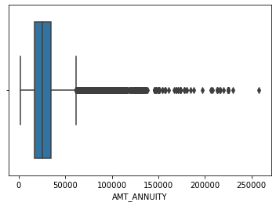
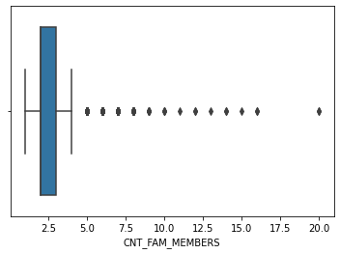
For “AMT_ANNUITY” column the mean is 27117 where as the max is 225000.
For “CNT_FAM_MEMBERS” column the mean is 2 where as the max is 17.

Slide 5
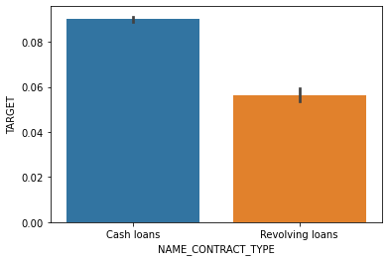
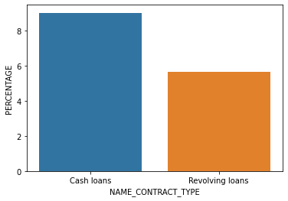
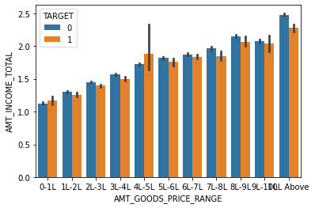
For “NAME_CONTRACT_TYPE” number of contracts of type ‘cash loans’ are more than ‘revolving loans’.
There are very low defaulters for revolving loan type contract.

Slide 6
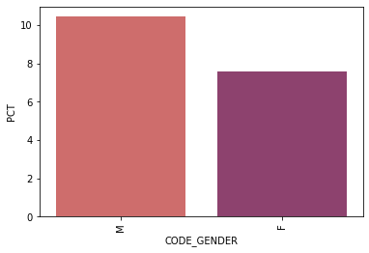
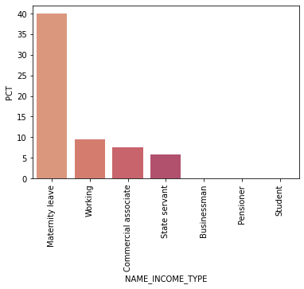
Male and Female gender ratio for total number of rows are againt to pct we found different ratios.
the number of female is almost double to number of male .
Males have a higher cg=hance of not returning their loans 10%,compare to 7%
Maternity leave income types has the highest % about 40% and state servant having thr least about5-7%

Slide 7
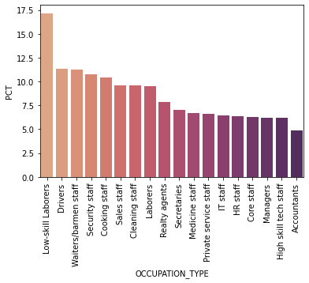
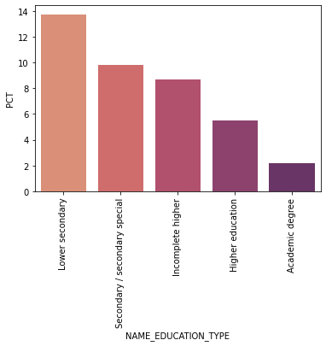
Laborer’s 45k,sales,core staff has highest number of loan but when it come to non loan repayment highest number can be seen in low laborers 16%,drivers,waiters,cooking staff and so on
A large number of applications are filled by people having secondary education followed by people with higher education applications.the applicants with lower secondary education status has the highest % of payment related problems.

Slide 8
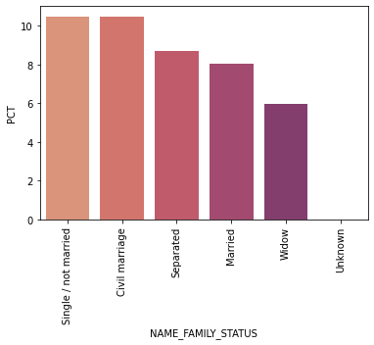
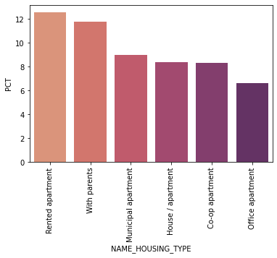
Most of the clients are the married or single followed by civil marriage .
Percentage of not repayment of loan,civil marriage has the highest percent of not repayment with widow the lowest.
Applicants living in house /aparments has the highest number of loan applications.While the rented apartment and applicants living with highest percentage abour12% to11%approx.

Slide 9
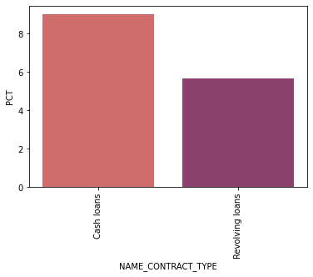
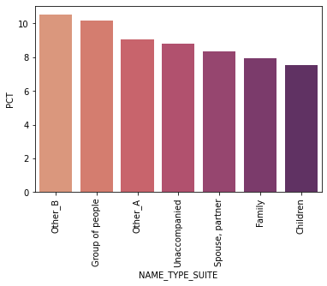

Slide 10
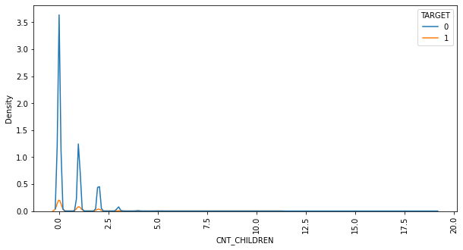
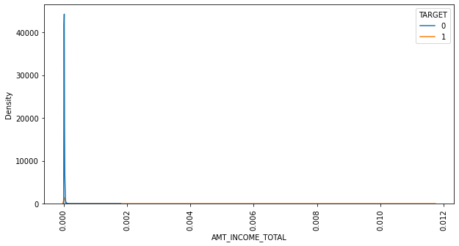
Applicants who have children’s are more likely to be defaulters.
If the clients income is high then the client may not default the bank .the applicant for customer loans isv likely to be non defaulter than being defaulter.if the clients days employed is above 350000 thanit has more number of non defaulters than likelt to default.

Slide 11
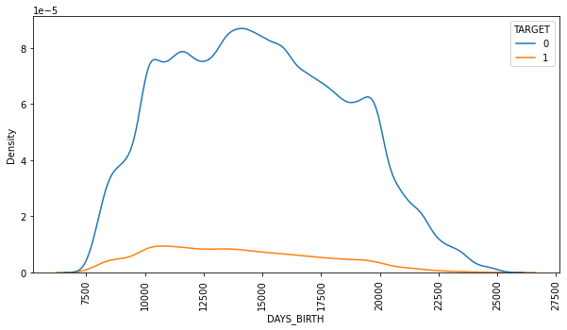
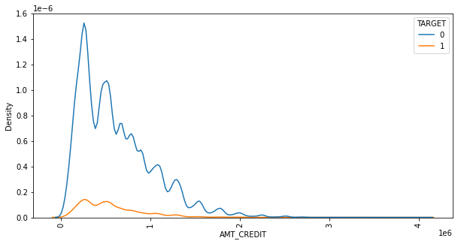
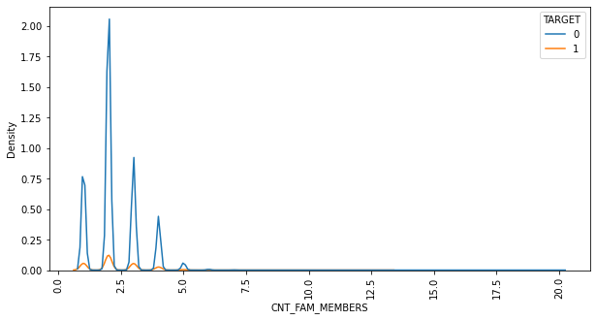
The age range is betweenapprox 20 and 68 years
Client with payment difficulties are more concentrated in the age of 25-35 and it goes on decreasing

Slide 12
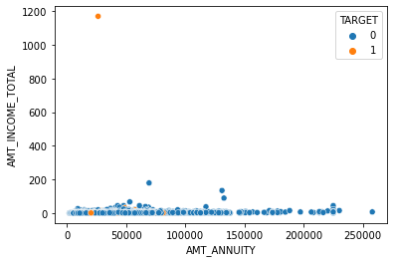
Most highest defaulter between 1000-12000 and there are so many non defaulters

Slide 13
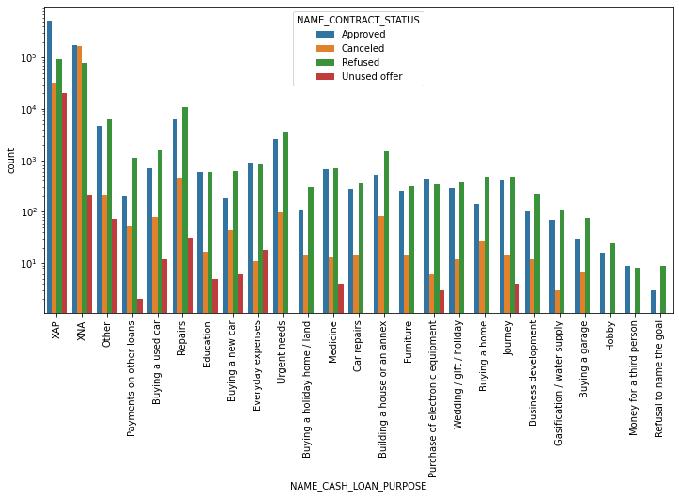
Most rejection of loans came from purpose”repairs”.For education purposes we have eqal number of approvals and rejection .Paying other loans and buying a new car is having significant higher rejection than approvals.

Slide 14
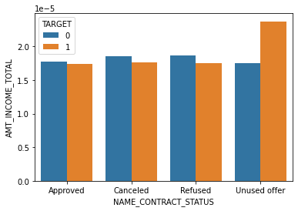
Unused offer has the most higher defaulter and non defaulters

Slide 15
CONCLUSION
Most of the Male loan applicants are drivers and laborers and have more credit amount and lesser income, so we should limit down the credit amount to these kind of clients.
Most of the Female loan applicants are sales and labrores and have more credit amount to these kind of clients.

